Slide 1
Optimizing & Scheduling of Examination Dates
Team : Lilly Abraham, Megha Eldho, Deva Dharshini Rajarajeswari, Akshay Augustine Sheby
Supervised by : Prof Dr Frank Michael Schlief

Slide 2
Input Files for THWS(FIW-Computer Science & Business Informatics):
Exam Registration File
Course File
Room File

Slide 3



3 Approaches

Slide 4
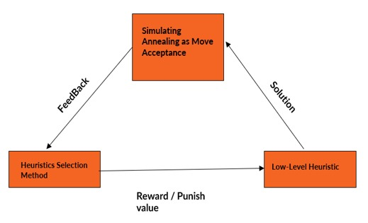
Reinforcement Learning Simulated Annealing Hyper heuristic Framework

Slide 5
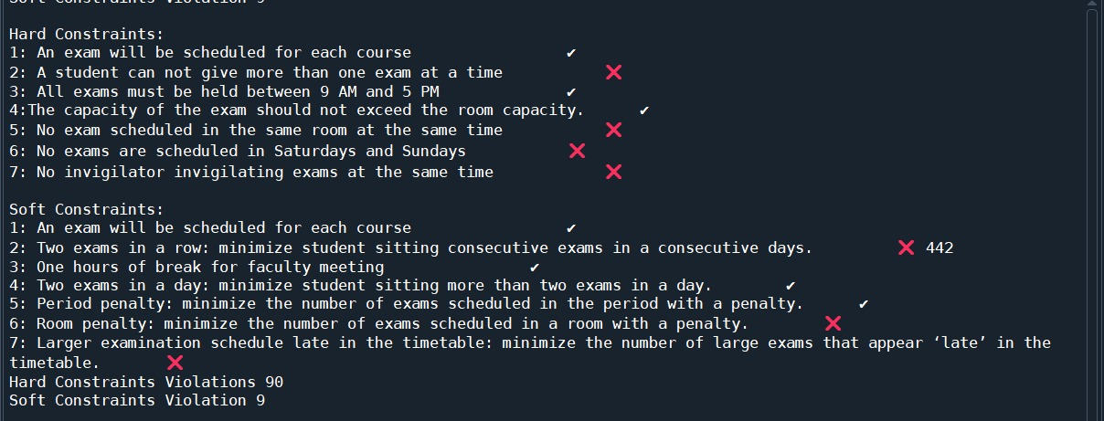
Results

Slide 6
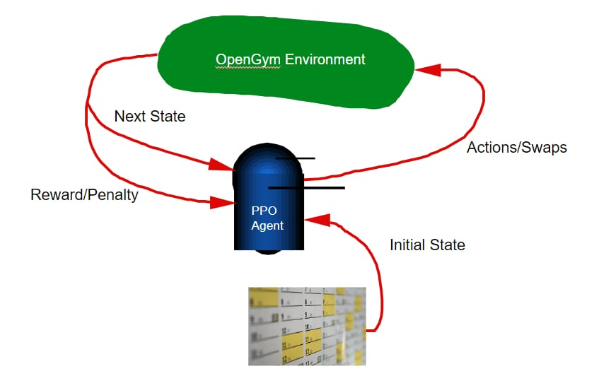
Reinforcement Learning PPO Framework

Slide 7
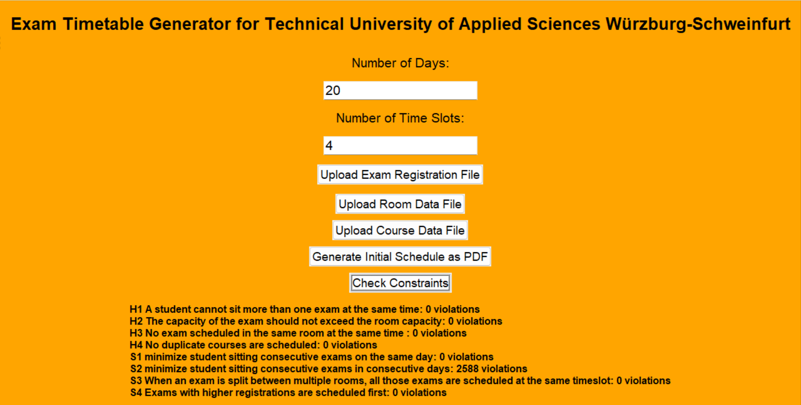
Results

Slide 8
Exam Schedule

Slide 9
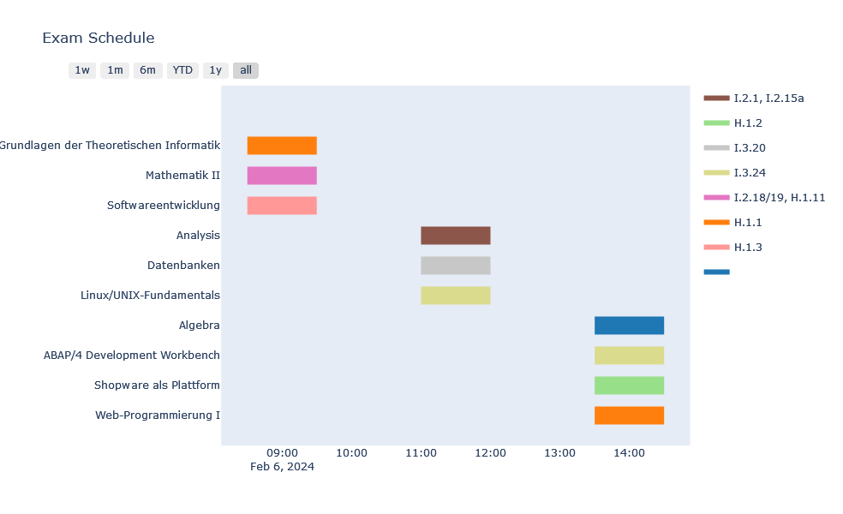
Genetic Algorithm
Gantt Chart

Slide 10
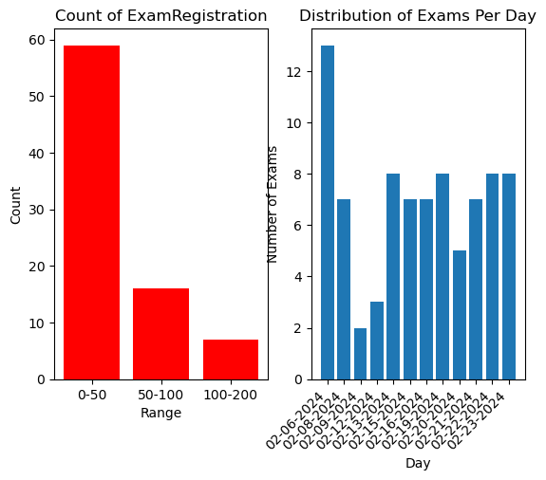

Slide 11
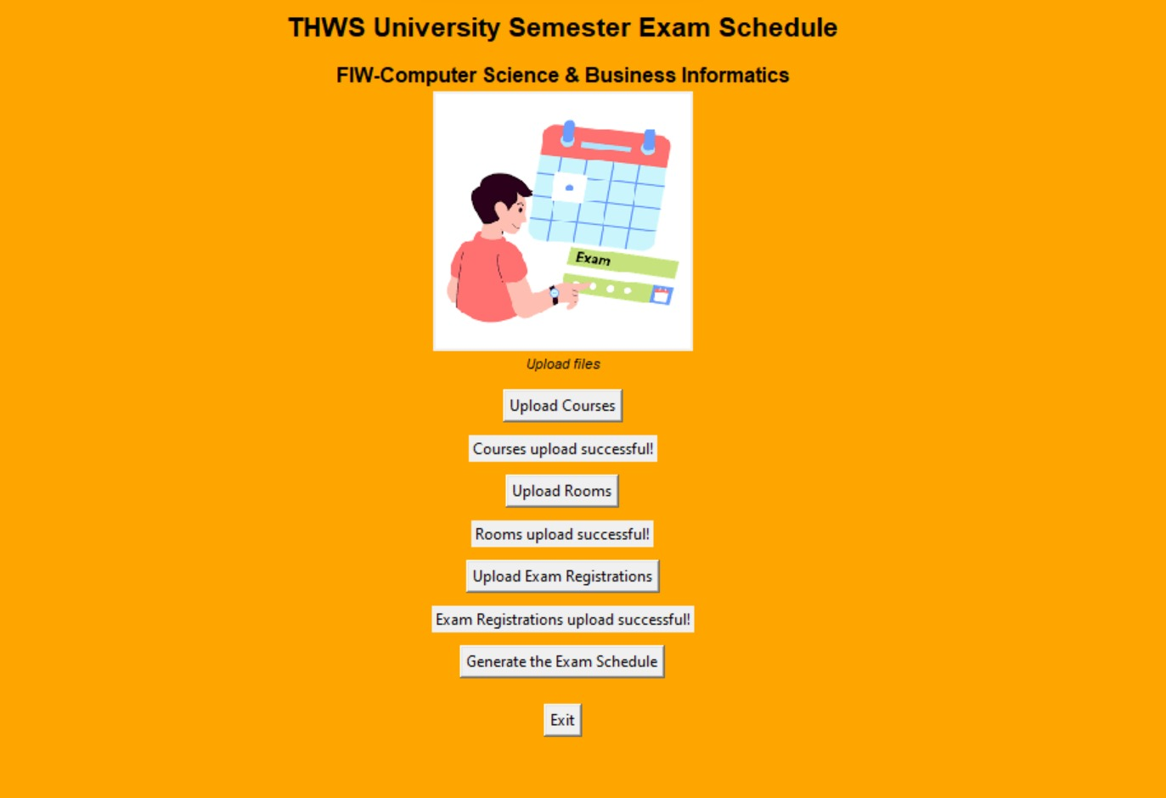

Slide 12
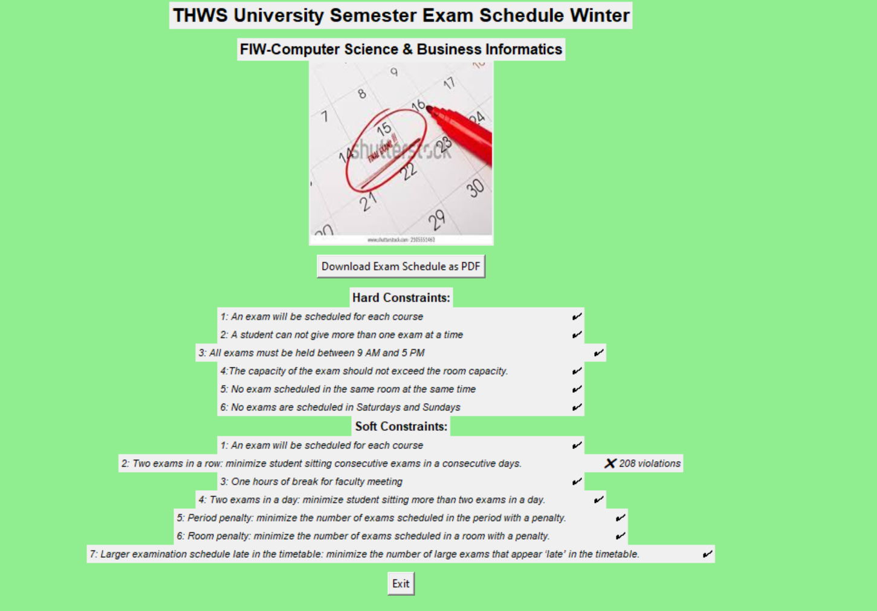
Results

Slide 13
Exam Schedule

Slide 14

Thank You

